Slide 1
Loss Functions and Optimization. Gradient Descent Algorithm.
Radu Ionescu, Prof. PhD.
raducu.ionescu@gmail.com
Faculty of Mathematics and Computer Science
University of Bucharest

Slide 2
Grading System
Extra points during lectures / labs
awarded only in the first round of evaluation
Lectures:
awarded based on the ranking of answers on Kahoot
top 3 get up to 0.3 points per lecture, next 3 up to 0.2 points and so on
Labs:
first to answer solve an exercise gets 0.2 points
maximum 0.4 points per lab for each student
Up to 1 bonus point during lectures (added to final grade)
Up to 1 bonus point during labs (added to final grade)
Up to 2 bonus points for some data annotation

Slide 3
Grading System
Annotation task:
Annotate the relevance of generated images with respect to some input prompt
Annotation platform:
https://prompt-predict.web.app
Awarding bonus points rules:
0.5 points for every 120 text samples (40 pages) ~ 1 hour
minimum Quadratic Weighted Kappa of 0.4 w.r.t. some control examples
check the tutorial before starting the annotation
maximum 2 bonus points (480 text samples)
there will be 3 annotators per example and there are 10,000 examples

Slide 4
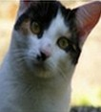
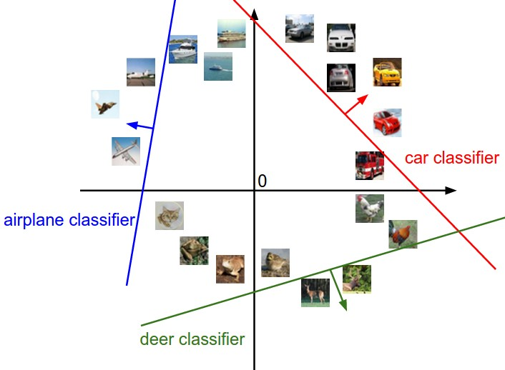
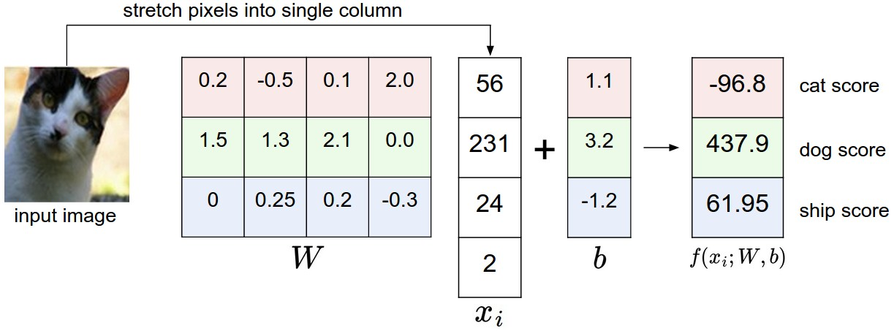
Linear classifier for the multi-class problem
image
parameters
10 numbers, indicating class scores
f(x,W)
[32x32x3]
array of numbers 0...1
(3072 numbers total)

Slide 5
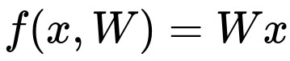

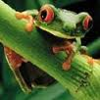
Suppose: 3 training examples, 3 classes.
With some W the scores are:
cat
3.2
1.3
2.2
car
5.1
4.9
2.5
-1.7
2.0
-3.1
frog

Slide 6
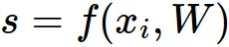
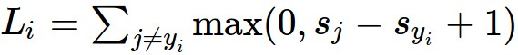
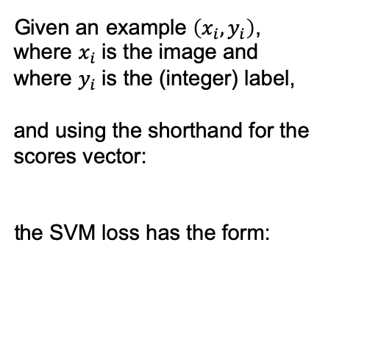
Suppose: 3 training examples, 3 classes.
With some W the scores are:
Multiclass SVM loss:
Given an example $\left(x_{i},y_{i}\right)$,
where $x_{i}$is the image and
where $y_{i}$is the (integer) label,
and using the shorthand for the scores vector:
the SVM loss has the form:
cat
3.2
1.3
2.2
car
5.1
4.9
2.5
-1.7
2.0
-3.1
frog

Slide 7
Suppose: 3 training examples, 3 classes.
With some W the scores are:
Multiclass SVM loss:
Given an example $\left(x_{i},y_{i}\right)$,
where $x_{i}$is the image and
where $y_{i}$is the (integer) label,
and using the shorthand for the scores vector:
the SVM loss has the form:
cat
3.2
1.3
2.2
car
5.1
4.9
2.5
= max(0, 5.1 - 3.2 + 1)
+max(0, -1.7 - 3.2 + 1)
= max(0, 2.9) + max(0, -3.9)
= 2.9 + 0
= 2.9
-1.7
2.0
-3.1
frog
Losses:
2.9

Slide 8
Suppose: 3 training examples, 3 classes.
With some W the scores are:
Multiclass SVM loss:
Given an example $\left(x_{i},y_{i}\right)$,
where $x_{i}$is the image and
where $y_{i}$is the (integer) label,
and using the shorthand for the scores vector:
the SVM loss has the form:
cat
3.2
1.3
2.2
car
5.1
4.9
2.5
= max(0, 1.3 - 4.9 + 1)
+max(0, 2.0 - 4.9 + 1)
= max(0, -2.6) + max(0, -1.9)
= 0 + 0
= 0
-1.7
2.0
-3.1
frog
Losses:
2.9
0

Slide 9
Suppose: 3 training examples, 3 classes.
With some W the scores are:
Multiclass SVM loss:
Given an example $\left(x_{i},y_{i}\right)$,
where $x_{i}$is the image and
where $y_{i}$is the (integer) label,
and using the shorthand for the scores vector:
the SVM loss has the form:
cat
3.2
1.3
2.2
car
5.1
4.9
2.5
= max(0, 2.2 - (-3.1) + 1)
+max(0, 2.5 - (-3.1) + 1)
= max(0, 6.3) + max(0, 6.6)
= 6.3 + 6.6
= 12.9
-1.7
2.0
-3.1
frog
Losses:
2.9
0
12.9

Slide 10
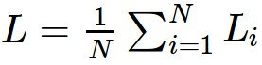
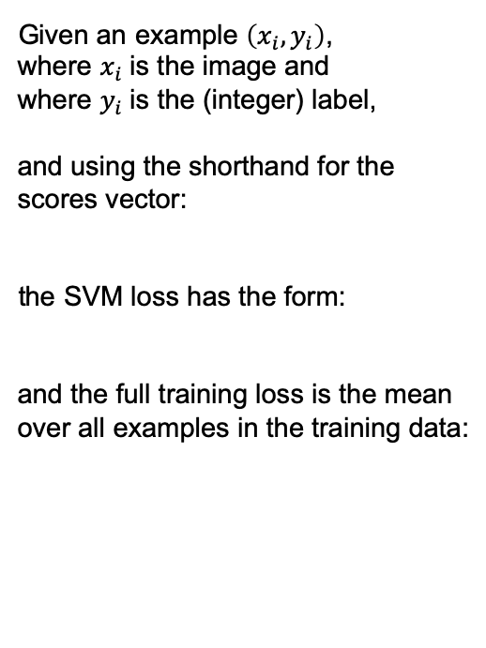
Suppose: 3 training examples, 3 classes.
With some W the scores are:
Multiclass SVM loss:
Given an example $\left(x_{i},y_{i}\right)$,
where $x_{i}$is the image and
where $y_{i}$is the (integer) label,
and using the shorthand for the scores vector:
the SVM loss has the form:
and the full training loss is the mean over all examples in the training data:
cat
3.2
1.3
2.2
car
5.1
4.9
2.5
-1.7
2.0
-3.1
frog
Losses:
2.9
0
12.9
L = (2.9 + 0 + 12.9)/3
= 5.27

Slide 11
Softmax Classifier (Multinomial Logistic Regression)
cat
3.2
car
5.1
-1.7
frog

Slide 12
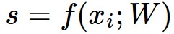
Softmax Classifier (Multinomial Logistic Regression)
scores = unnormalized log probabilities of the classes.
cat
3.2
car
5.1
-1.7
frog

Slide 13
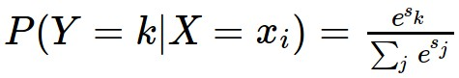
Softmax Classifier (Multinomial Logistic Regression)
scores = unnormalized log probabilities of the classes
where
cat
3.2
car
5.1
-1.7
frog

Slide 14
Softmax Classifier (Multinomial Logistic Regression)
scores = unnormalized log probabilities of the classes.
where
cat
3.2
Softmax function
car
5.1
-1.7
frog

Slide 15
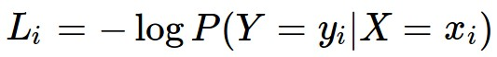
Softmax Classifier (Multinomial Logistic Regression)
scores = unnormalized log probabilities of the classes.
Want to maximize the log likelihood, or (for a loss function)
to minimize the negative log likelihood of the correct class:
where
cat
3.2
car
5.1
-1.7
frog

Slide 16
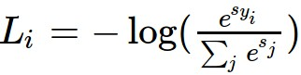
Softmax Classifier (Multinomial Logistic Regression)
scores = unnormalized log probabilities of the classes.
Want to maximize the log likelihood, or (for a loss function)
to minimize the negative log likelihood of the correct class:
where
cat
3.2
car
5.1
-1.7
frog
in summary:

Slide 17
Softmax Classifier (Multinomial Logistic Regression)
cat
3.2
car
5.1
-1.7
frog
unnormalized log probabilities

Slide 18
Softmax Classifier (Multinomial Logistic Regression)
unnormalized probabilities
cat
3.2
24.5
exp
car
5.1
164.0
-1.7
0.18
frog
unnormalized log probabilities

Slide 19
Softmax Classifier (Multinomial Logistic Regression)
unnormalized probabilities
cat
3.2
24.5
0.13
exp
normalize
car
5.1
164.0
0.87
-1.7
0.18
0.00
frog
unnormalized log probabilities
probabilities

Slide 20
Softmax Classifier (Multinomial Logistic Regression)
unnormalized probabilities
cat
3.2
24.5
0.13
L_{i} = -log(0.13)
= 0.89
exp
normalize
car
5.1
164.0
0.87
-1.7
0.18
0.00
frog
unnormalized log probabilities
probabilities

Slide 21
Softmax Classifier (Multinomial Logistic Regression)
Q: What is the min/max possible loss L_{i}?
unnormalized probabilities
cat
3.2
24.5
0.13
L_{i} = -log(0.13)
= 0.89
exp
normalize
car
5.1
164.0
0.87
-1.7
0.18
0.00
frog
unnormalized log probabilities
probabilities

Slide 22
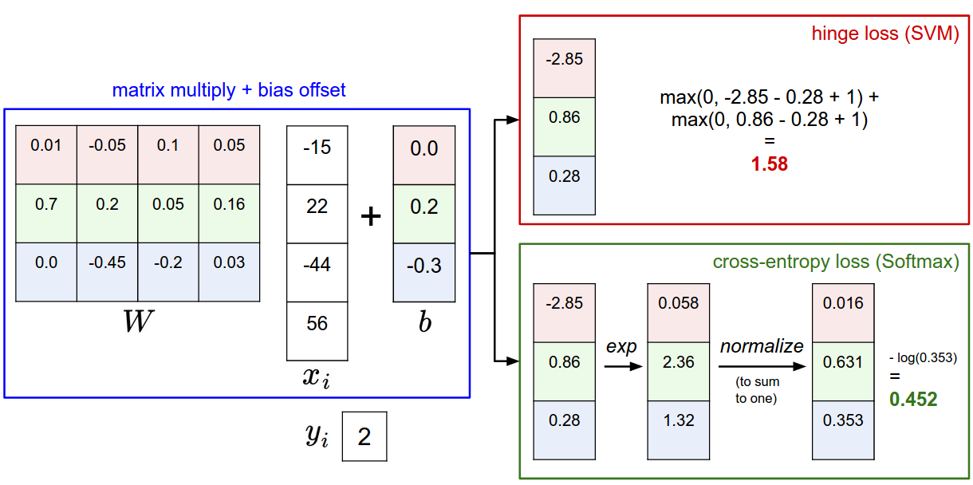

Slide 23
Softmax vs. SVM

Slide 24
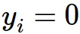
Softmax vs. SVM
assume scores:
[10, -2, 3]
[10, 9, 9]
[10, -100, -100]
and
Q: Suppose we take a datapoint and we add some small perturbations (changing its score slightly). What happens to the loss in both cases?

Slide 25
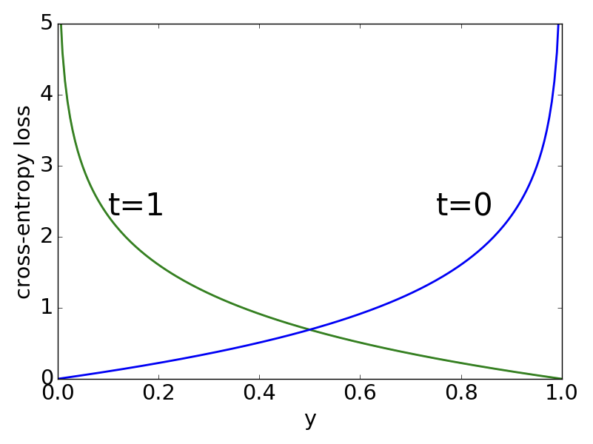
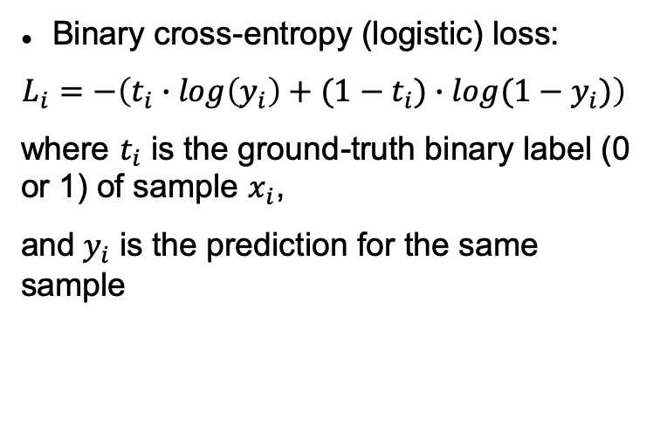
Binary cross-entropy loss
Binary cross-entropy (logistic) loss:
$$L_{i}=−\left(t_{i}∙log\left(y_{i}\right)+(1−t_{i})∙log(1−y_{i})\right)$$
where $t_{i}$ is the ground-truth binary label (0 or 1) of sample $x_{i}$,
and${ y}_{i}$ is the prediction for the same sample

Slide 26
Optimization

Slide 27
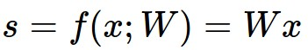
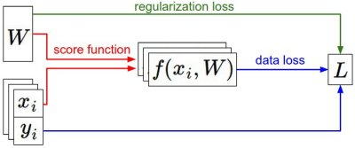
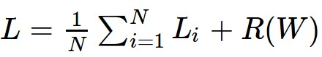
Until now:
We have some dataset of (x,y)
We have a score function:
We have a loss function:
e.g.
Softmax
SVM
Full loss

Slide 28
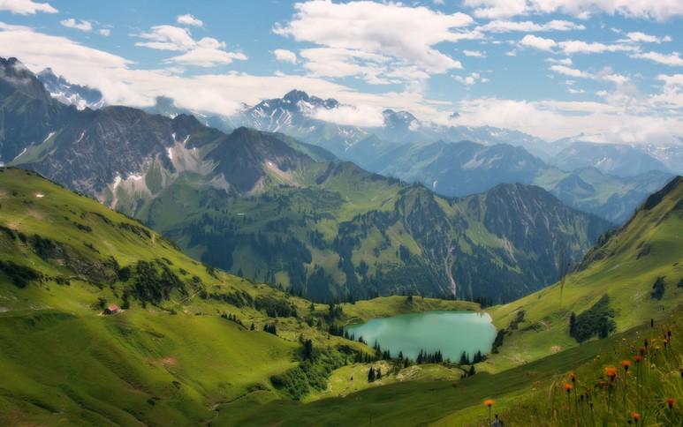

Gradient Descent Algorithm

Slide 29
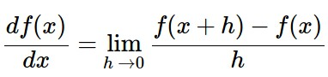
Gradient Descent Algorithm
In 1-dimension, the derivative of a function:
In multiple dimensions, the gradient is the vector of partial derivatives.

Slide 30
current W:
[0.34,
-1.11,
0.78,
0.12,
0.55,
2.81,
-3.1,
-1.5,
0.33,…]
loss 1.25347
gradient dW:
[?,
?,
?,
?,
?,
?,
?,
?,
?,…]

Slide 31
current W:
[0.34,
-1.11,
0.78,
0.12,
0.55,
2.81,
-3.1,
-1.5,
0.33,…]
loss 1.25347
W + h (first dim):
[0.34 + 0.0001,
-1.11,
0.78,
0.12,
0.55,
2.81,
-3.1,
-1.5,
0.33,…]
loss 1.25322
gradient dW:
[?,
?,
?,
?,
?,
?,
?,
?,
?,…]

Slide 32
current W:
[0.34,
-1.11,
0.78,
0.12,
0.55,
2.81,
-3.1,
-1.5,
0.33,…]
loss 1.25347
W + h (first dim):
[0.34 + 0.0001,
-1.11,
0.78,
0.12,
0.55,
2.81,
-3.1,
-1.5,
0.33,…]
loss 1.25322
gradient dW:
[-2.5,
?,
?,
?,
?,
?,
?,
?,
?,…]
(1.25322 - 1.25347)/0.0001
= -2.5

Slide 33
current W:
[0.34,
-1.11,
0.78,
0.12,
0.55,
2.81,
-3.1,
-1.5,
0.33,…]
loss 1.25347
W + h (second dim):
[0.34,
-1.11 + 0.0001,
0.78,
0.12,
0.55,
2.81,
-3.1,
-1.5,
0.33,…]
loss 1.25353
gradient dW:
[-2.5,
?,
?,
?,
?,
?,
?,
?,
?,…]

Slide 34
current W:
[0.34,
-1.11,
0.78,
0.12,
0.55,
2.81,
-3.1,
-1.5,
0.33,…]
loss 1.25347
W + h (second dim):
[0.34,
-1.11 + 0.0001,
0.78,
0.12,
0.55,
2.81,
-3.1,
-1.5,
0.33,…]
loss 1.25353
gradient dW:
[-2.5,
0.6,
?,
?,
?,
?,
?,
?,
?,…]
(1.25353 - 1.25347)/0.0001
= 0.6

Slide 35
current W:
[0.34,
-1.11,
0.78,
0.12,
0.55,
2.81,
-3.1,
-1.5,
0.33,…]
loss 1.25347
W + h (third dim):
[0.34,
-1.11,
0.78 + 0.0001,
0.12,
0.55,
2.81,
-3.1,
-1.5,
0.33,…]
loss 1.25347
gradient dW:
[-2.5,
0.6,
?,
?,
?,
?,
?,
?,
?,…]

Slide 36
current W:
[0.34,
-1.11,
0.78,
0.12,
0.55,
2.81,
-3.1,
-1.5,
0.33,…]
loss 1.25347
W + h (third dim):
[0.34,
-1.11,
0.78 + 0.0001,
0.12,
0.55,
2.81,
-3.1,
-1.5,
0.33,…]
loss 1.25347
gradient dW:
[-2.5,
0.6,
0,
?,
?,
?,
?,
?,
?,…]
(1.25347 - 1.25347)/0.0001
= 0

Slide 37
Gradient Evaluation
1) Numerical approach
We choose a small positive h and apply the formula:
We obtain an approximate value
Very slow to compute
2) Analytic approach
We use calculus to determine the gradient’s formula as a function of X and W

Slide 38
Gradient Evaluation (Python)
def f(x):
y = 0.5 * (x**4) - 2 * (x**2) + x + 5
return y
# 1) Numerical Method
h = 0.001
gradient = (f(x + h) - f(x)) / h
# 2) Analythic Method
def f_prime(x):
y_prime = 2 * (x**3) - 4 * x + 1
return y_prime
gradient = f_prime(x)

Slide 39
current W:
[0.34,
-1.11,
0.78,
0.12,
0.55,
2.81,
-3.1,
-1.5,
0.33,…]
loss 1.25347
gradient dW:
[-2.5,
0.6,
0,
0.2,
0.7,
-0.5,
1.1,
1.3,
-2.1,…]
dW = ...
(some function of x and W)

Slide 40
In summary:
Numerical gradient: approximate, slow, easy to write
Analytic gradient: exact, fast, error-prone
=>
In practice: Always use analytic gradient, but check implementation with numerical gradient. This is called a gradient checking.

Slide 41
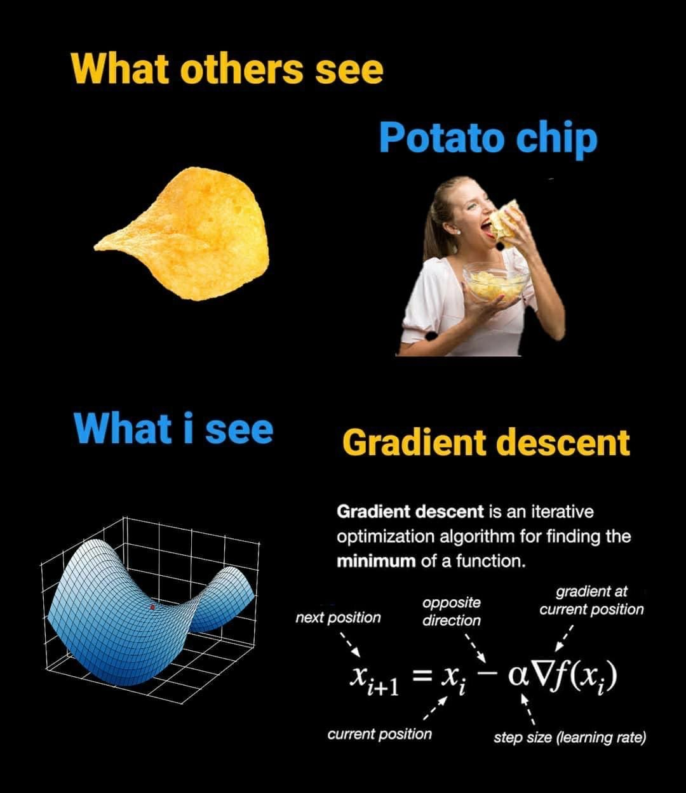

Slide 42
Gradient Descent (Python)
def GD(W0, X, goal, learningRate):
perfGoalNotMet = true
W = W0
while perfGoalNotMet:
gradient = eval_gradient(X, W)
W_old = W
W = W – learningRate * gradient
perfGoalNotMet = sum(abs(W - W_old)) > goal

Slide 43
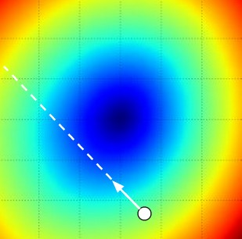
W₂
current W
W₁
negative gradient direction

Slide 44
Mini-batch Gradient Descent
Also known as Stochastic Gradient Descent (SGD)
Only use a small portion of the training set to compute the gradient:
. . .
while perfGoalNotMet:
X_batch = select_random_subsample(X)
gradient = eval_gradient(@loss, X_batch, W)
. . .
Common mini-batch sizes are 32/64/128 examples
e.g. Krizhevsky’s ILSVRC ConvNet used 256 examples

Slide 45
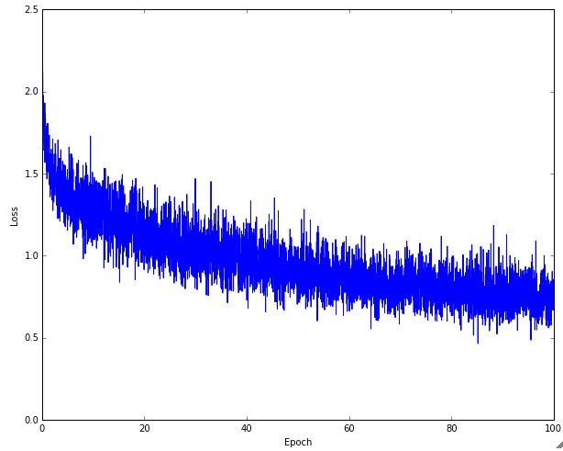
Example of optimization progress while training a neural network with SGD.
(Loss over mini-batches goes down over time)

Slide 46
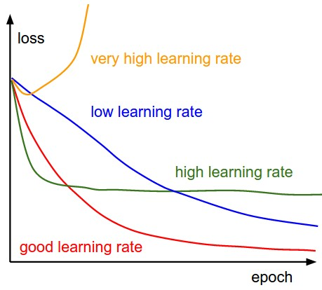
The effects of step size (or “learning rate”)

Slide 47
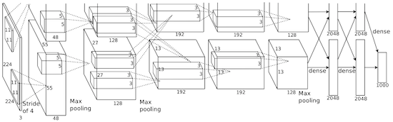
From feature extract to end-to-end learning
vector describing various image statistics
f
Feature Extraction
N numbers, indicating class scores
training
[32x32x3]
f
N numbers, indicating class scores
training
[32x32x3]

Slide 48
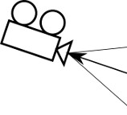
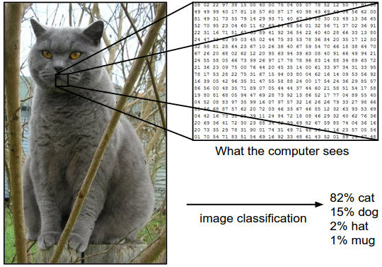
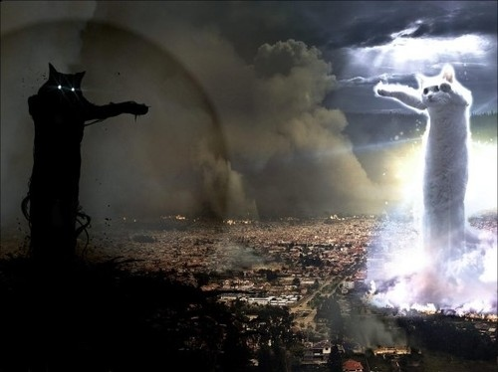

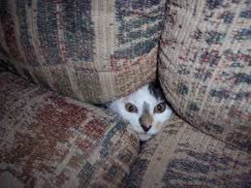
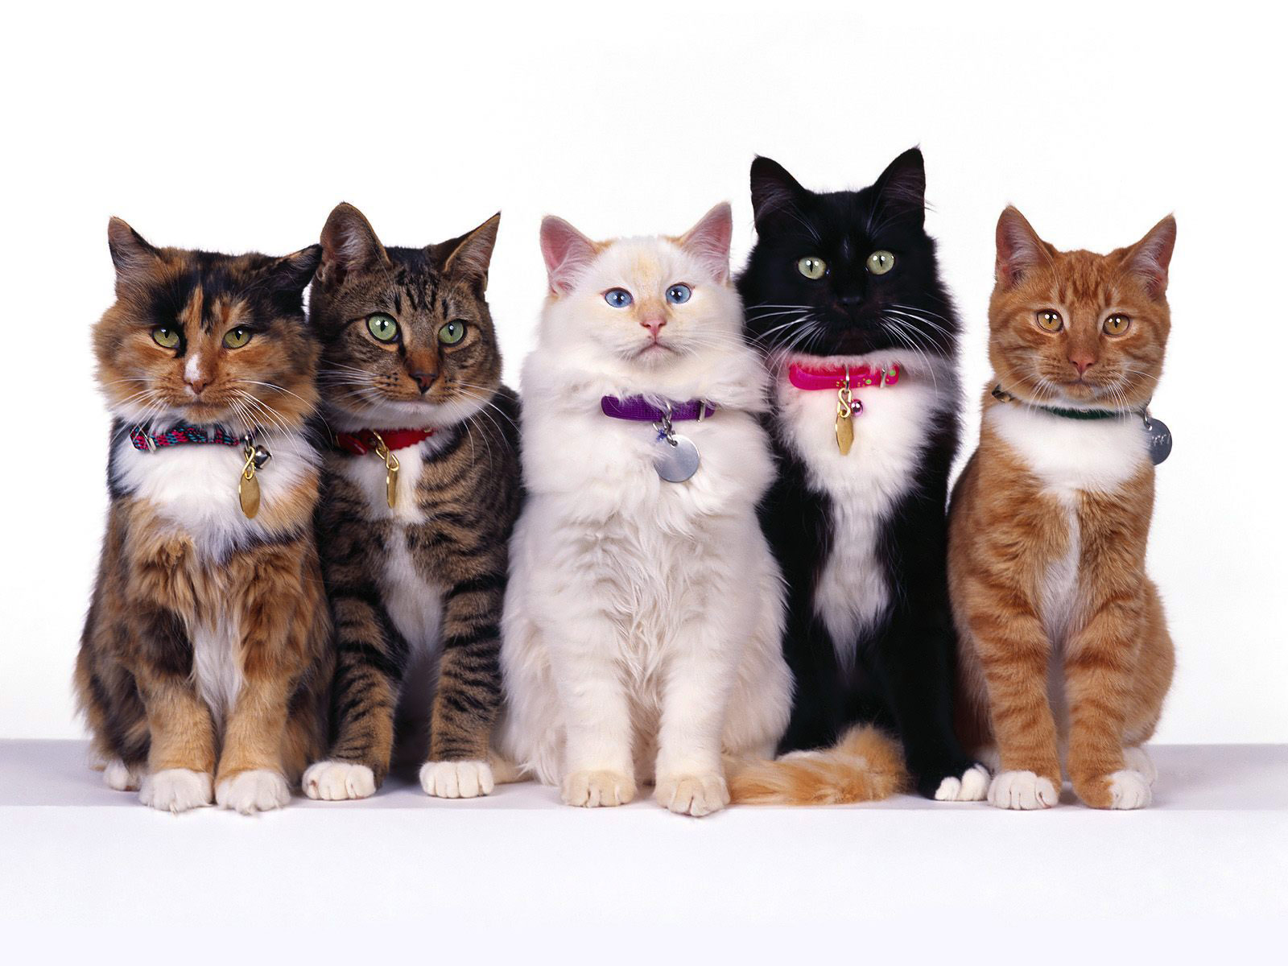
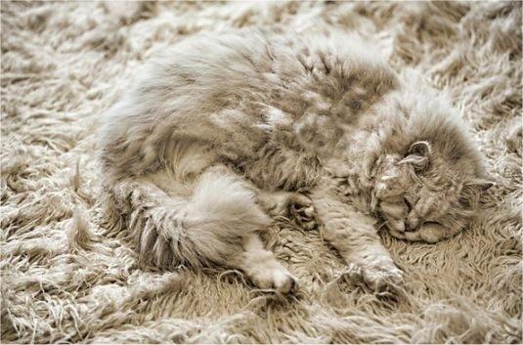
Challenges in Visual Recognition
Camera pose
Illumination
Deformation
Occlusion
Background clutter
Intra-class variation

Slide 49
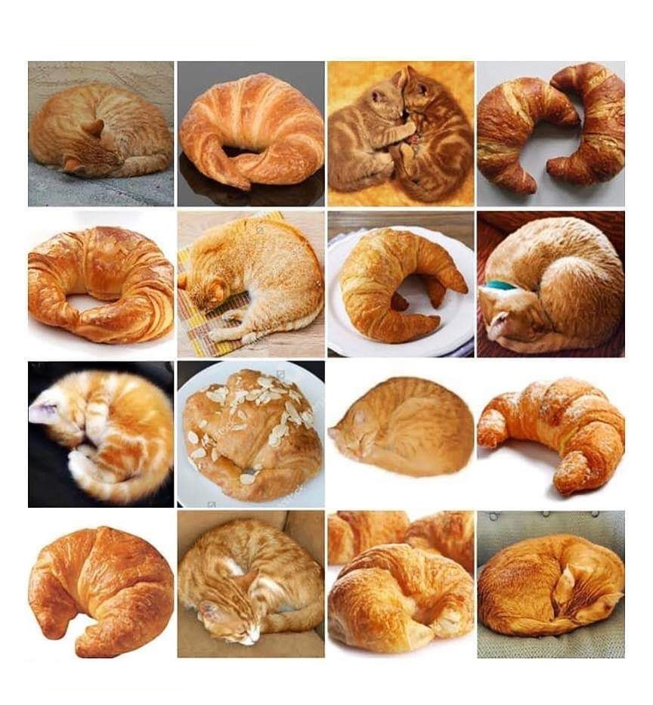
Inter-class similarity

Slide 50
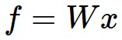
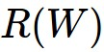
Computational Graph
x
*
s (scoruri)
Hinge loss
+
L
W
R

Slide 51
Convolutional Network
(AlexNet)
input image
weights
loss

Slide 52
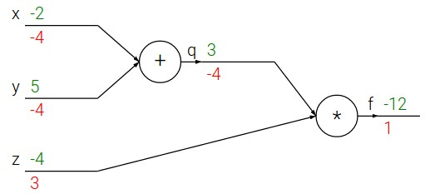
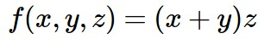
e.g. x = -2, y = 5, z = -4

Slide 53
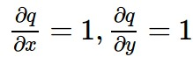
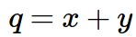
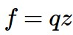
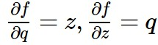
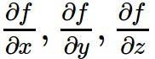
e.g. x = -2, y = 5, z = -4
Want:

Slide 54
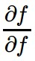
e.g. x = -2, y = 5, z = -4
Want:

Slide 55
e.g. x = -2, y = 5, z = -4
Want:

Slide 56
e.g. x = -2, y = 5, z = -4
Want:

Slide 57
e.g. x = -2, y = 5, z = -4
Want:

Slide 58
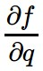
e.g. x = -2, y = 5, z = -4
Want:

Slide 59
e.g. x = -2, y = 5, z = -4
Want:

Slide 60
e.g. x = -2, y = 5, z = -4
Want:

Slide 61
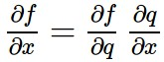
e.g. x = -2, y = 5, z = -4
Chain rule:
Want:

Slide 62
e.g. x = -2, y = 5, z = -4
Want:

Slide 63
e.g. x = -2, y = 5, z = -4
Chain rule:
vrem:

Slide 64
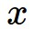
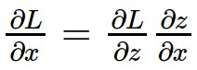
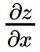





Gradient propagation using chain rule
activations
f
“local gradient”
gradients

Slide 65




Another example:

Slide 66
Another example:

Slide 67

Another example:

Slide 68
Another example:

Slide 69

Another example:

Slide 70
Another example:

Slide 71

Another example:

Slide 72
Another example:

Slide 73
Another example:
(-1) * (-0.20) = 0.20

Slide 74
Another example:

Slide 75
Another example:
[local gradient] x [computed gradient]
[1] x [0.2] = 0.2
[1] x [0.2] = 0.2 (both inputs)

Slide 76
Un alt exemplu:

Slide 77
Un alt exemplu:
[local gradient] x [computed gradient]
x0: [2] x [0.2] = 0.4
w0: [-1] x [0.2] = -0.2

Slide 78


sigmoid function
sigmoid gate
(0.73) * (1 - 0.73) = 0.2

Slide 79

Patterns in backward prop
add gate: gradient distributor
max gate: gradient router
mul gate: gradient… “switcher”?

Slide 80
Gradients add at branches
+

Slide 81


Forward/backward propagation for mul gate (Python)
x
z
*
(x, y, z are scalars)
def forward(x,y):
z = x * y
layer.input = [x, y] # for backward
return z
def backward(dz):
dx = layer.input[1] * dz # dz/dx * dL/dz
dy = layer.input[0] * dz # dz/dy * dL/dz
return [dx, dy]
y

Slide 82
Gradients for vectorial code
(x, y, z are now vectors)
This is now the Jacobian matrix (derivative of each element of z w.r.t. each element of x)
f
“local gradient”
gradients

Slide 83

Vectorized operations
Jacobian matrix
f(x) = max(0,x)
(elementwise)
4096-d
input vector
4096-d
output vector
Q: what is the size of the Jacobian matrix?
[4096 x 4096]

Slide 84
Vectorized operations
In practice we process an entire minibatch (e.g. 100) of examples at one time:
max(0,x)
(elementwise)
f(x) = max(0,x)
(elementwise)
100 4096-d
input vectors
100 4096-d
output vectors
i.e. the Jacobian would technically be a 100 x [4096 x 4096] matrix

Slide 85
Summary so far
Neural nets will be very large: no hope of writing down gradient formula by hand for all parameters
Backpropagation = recursive application of the chain rule along a computational graph to compute the gradients of all inputs / parameters / intermediates
Implementations maintain a graph structure, where the nodes implement the forward() / backward() API
Forward: compute result of an operation and save any intermediates needed for gradient computation in memory
Backward: apply the chain rule to compute the gradient of the loss function with respect to the inputs

Slide 86


Slide 87


Neural Network: without the brain stuff
(Before) Linear score function:
(Now) 2-layer Neural Network
x
h
W1
W2
s
3072
100
10

Slide 88

Neural Network: without the brain stuff
(Before) Linear score function:
(Now) 2-layer Neural Network
or 3-layer Neural Network

Slide 89
Training a 2-layer Neural Network needs ~11 lines (Python)
X = np.array([[0,0,1],[0,1,1],[1,0,1],[1,1,1]])
Y = np.array([[0,1,1,0]]).T
W0 = 2 * np.random.random((3,4)) - 1
W1 = 2 * np.random.random((4,1)) - 1
for i in range(5000):
# forward pass
l1 = 1 / (1 + np.exp(-np.matmul(X, W0)))
l2 = 1 / (1 + np.exp(-np.matmul(l1, W1)))
# backward pass
delta_l2 = (Y - l2) * (l2 * (1 - l2))
delta_l1 = np.matmul(delta_l2, W1.T) * (l1 * (1 - l1))
# gradient descent
W1 = W1 + np.matmul(l1.T, delta_l2)
W0 = W0 + np.matmul(X.T, delta_l1)

Slide 90



The 2-layer neural network implemented in the previous slide
w_{1,1}
$$Σ$$
w_{2,1}
w_{1,1}
x_{i,1}
w_{3,1}
$$Σ$$
w_{2,1}
x_{i,2}
$$Σ$$
y
w_{3,1}
$$Σ$$
x_{i,3}
w_{2,4}
w_{1,4}
w_{4,1}
w_{3,4}
$$Σ$$
w_{1,1}
w_{2,1}
w_{3,1}
w_{4,1}
w_{1,1} w_{1,2} w_{1,3} w_{1,4}
w_{2,1} w_{2,2} w_{2,3} w_{2,4}
w_{3,1} w_{3,2} w_{3,3} w_{3,4}
W₁ =
W₀ =

